Slide 1

Note: The data and information in this document is reflective of a hypoetical situation and client. This document is to be used for KPMG Virtual Internship purposes only.
Sprocket Central Pty Ltd
Data analytics approach

Slide 2
Note: The data and information in this document is reflective of a hypothetical situation and client. This document is to be used for KPMG Virtual Internship purposes only.
Agenda
Introduction
Data Exploration
Model Development
Interpretation

Slide 3
Note: The data and information in this document is reflective of a hypothetical situation and client. This document is to be used for KPMG Virtual Internship purposes only.
Introduction
Optimising Sprocket Central Pty Ltd.'s marketing efforts
Sprocket Central Pty Ltd, a major manufacturer of high-quality bicycles and cycling accessories, intends to optimise its marketing efforts to accelerate business growth.
Using data analytic tools, we recommend improving Sprocket Central's consumer targeting approach. By diving into consumer demographics, locations, and transaction histories, we hope to unearth actionable data that will enable focused marketing efforts, eventually increasing the value of the organisation. In this session, we will discuss our strategy in three phases: data exploration, model development, and interpretation.

Slide 4
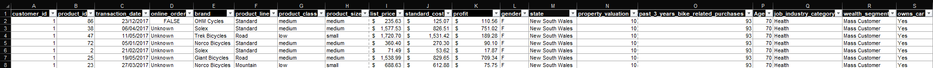
Note: The data and information in this document is reflective of a hypothetical situation and client. This document is to be used for KPMG Virtual Internship purposes only.
Data Exploration
Combined data from 2017’s transactions
As all the data had the primary key of “customer_id”, I combined keys that I deemed important for this analysis.
This was done by using the VLOOKUP function in the Transaction tab sheet to add “state” and “property_valuation” from the CustomerAddress tab sheet, and “gender”, “past_3_years_bike_related_purchases”, “age”, “job_industry_category”, “wealth_segment”, and “owns_car” from the CustomerDemographic tab sheet.
From the transaction tab, I removed “product_first_sold_date” and only kept those with “Approved” order status.

Slide 5
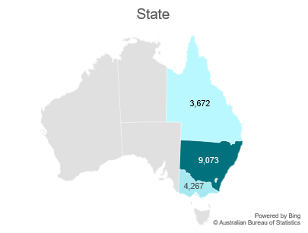
Note: The data and information in this document is reflective of a hypothetical situation and client. This document is to be used for KPMG Virtual Internship purposes only.
Model Development: Segmentation and Targeting
Transactions revealed a major target segment people aged 40 to 69 who are classified as mass consumers, work mostly in the financial services, health, and manufacturing industries, and live primarily in New South Wales.

Slide 6
Note: The data and information in this document is reflective of a hypothetical situation and client. This document is to be used for KPMG Virtual Internship purposes only.
Model Development: Customer Preference
This data reveals a significant preference for Medium class and size bicycle items, particularly those in the Standard product line. Notably, brands like Solex outperform the competition with comparable figures.
To effectively respond to these preferences, marketing efforts should provide personalised accessories to improve the consumer experience, particularly for those who choose a conventional, medium model.

Slide 7
Note: The data and information in this document is reflective of a hypothetical situation and client. This document is to be used for KPMG Virtual Internship purposes only.
Model Development: Price Optimisation
Analyzing the profit data, it's evident that WeareA2B, Solex, and Trek Bicycles are significant contributors to overall profit.
The Standard product line stands out as particularly profitable. Additionally, Medium-sized bicycles generate the most profit.

Slide 8
Note: The data and information in this document is reflective of a hypothetical situation and client. This document is to be used for KPMG Virtual Internship purposes only.
Model Development: Channel Optimisation
It appears that offline and online transactions are equally effective at boosting sales. However, with a considerable part of purchases categorised as unknown (18,917 cases).
So investing in digital marketing platforms such as social media ads and email campaigns to increase online sales. Simultaneously, having a strong presence in physical retail locations is critical for increasing in-person consumer interactions and brand awareness. Businesses may improve sales and customer engagement by integrating online and physical tactics that cater to a wide range of consumer tastes and behaviours.

Slide 9
Note: The data and information in this document is reflective of a hypothetical situation and client. This document is to be used for KPMG Virtual Internship purposes only.
Interpretation: Strategy
Segmentation and targeting: Customise marketing efforts to appeal to countless customers in a certain demographic, with a focus on personalised message and location-specific campaigns.
Customer Preferences: To capitalise on this choice, provide personalised accessories to improve the customer experience, particularly for those who like medium-sized, conventional bicycles.
Price Optimisation: To maximise profitability, optimise pricing within the Standard product range, with a concentration on Medium-sized bicycles.
Channel Optimisation: Invest in digital marketing channels (such as social media advertisements and email campaigns) to increase online sales while retaining a strong physical retail presence for in-person interactions and brand recognition. The integration of online and offline initiatives to adapt to various consumer tastes and behaviours is critical for increasing sales and engagement.

Slide 10
Note: The data and information in this document is reflective of a hypothetical situation and client. This document is to be used for KPMG Virtual Internship purposes only.
Appendix

